Slide 1
Simplified 리눅스 스케줄러(FIFO, RR)
국민대학교 임베디드 연구실
경 주 현
2017 LG MC 인재육성팀 교육

Slide 2
Outline
Simplified Linux scheduler(FIFO, RR)
Application : 스케줄러 System call 사용
트레이스 실습
Simplified Linux scheduler(FIFO, RR) 소스

Slide 3
The objectives of this pt is to learn
How to add a pluggable CPU scheduler in Linux kernel.
How to apply different scheduling policies to individual processes.
Learn the internal working of a CPU scheduler.

Slide 4
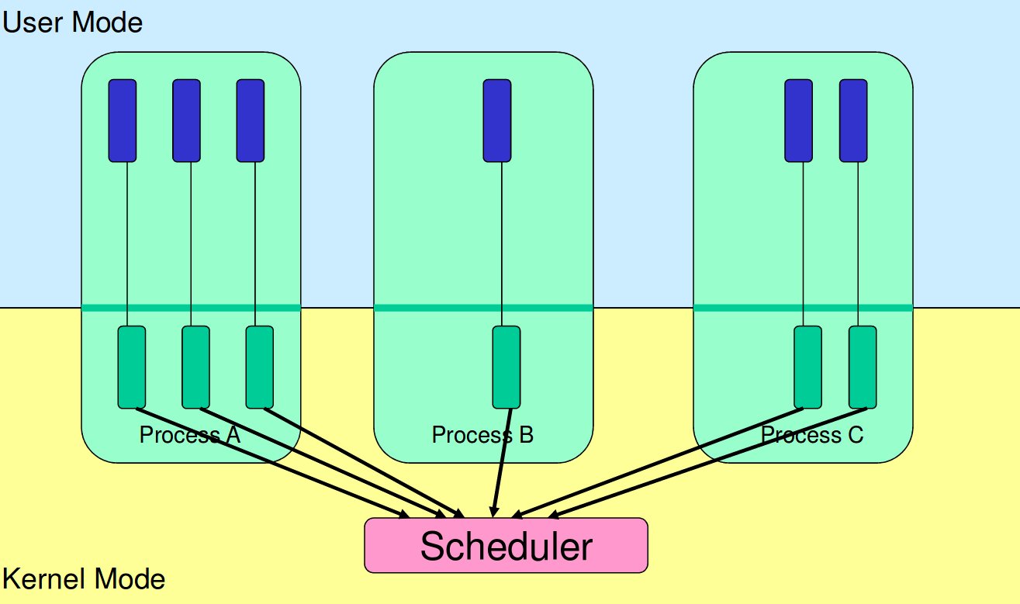
Kernel-level thread
https://cgi.cse.unsw.edu.au/~cs3231/12s1/lectures/SchedulerActivations.pdf

Slide 5
The key decisions made in the scheduler
“how to determine a thread’s timeslice? and how to pick the next thread to run”

Slide 6
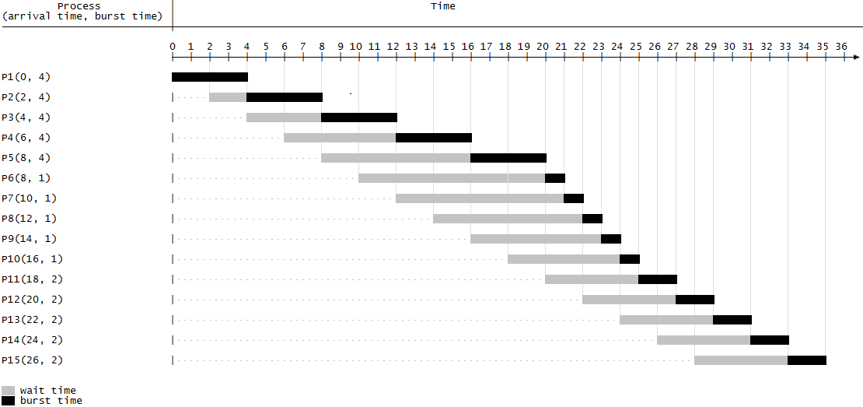
FIFO
first in, first out
Problem : starvation
https://en.wikipedia.org/wiki/FIFO_(computing_and_electronics)

Slide 7
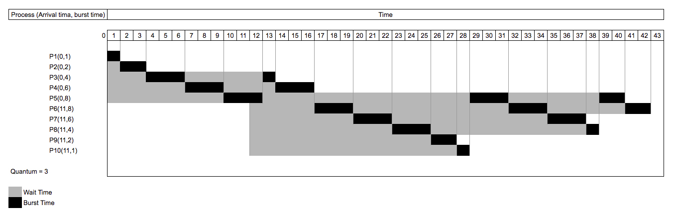
Round Robin
Simple, easy to implement, and starvation-free.

Slide 8
커널 소스 위치
/home/lkc/Desktop/linux-linaro-stable
Rootfs 위치
/home/lkc/Desktop/linux-linaro-stable/rootfs/initrd

Slide 9
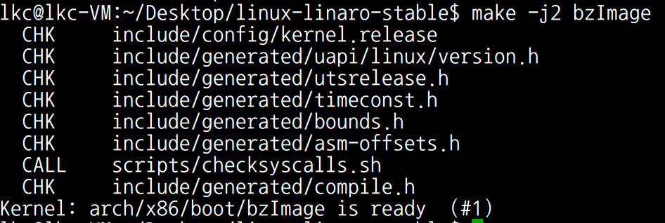
커널 컴파일
cd ~/Desktop/linux-linaro-stable
make -j2 bzImage

Slide 10
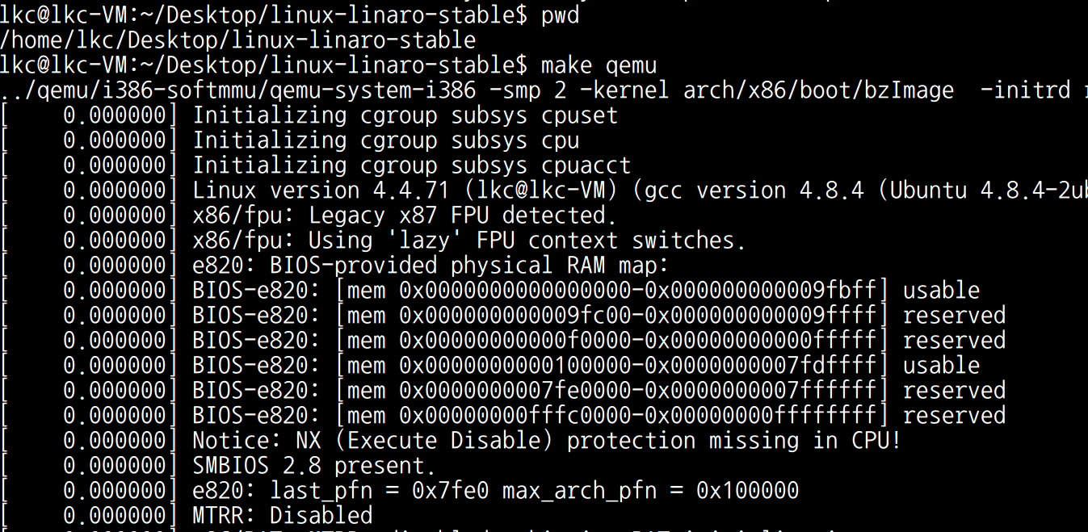
커널 실행
cd ~/Desktop/linux-linaro-stable
make qemu

Slide 11
User-level application
FIFO application
/home/lkc/Desktop/linux-linaro-stable/rootfs/initrd/root/sched/fifo_app.c
RR application
/home/lkc/Desktop/linux-linaro-stable/rootfs/initrd/root/sched/rr_app.c

Slide 12
FIFO scheduler 트레이스
trace-cmd 실행
nfs 폴더로 이동
/nfs # trace-cmd record -e sched /root/sched/fifo_app

Slide 13
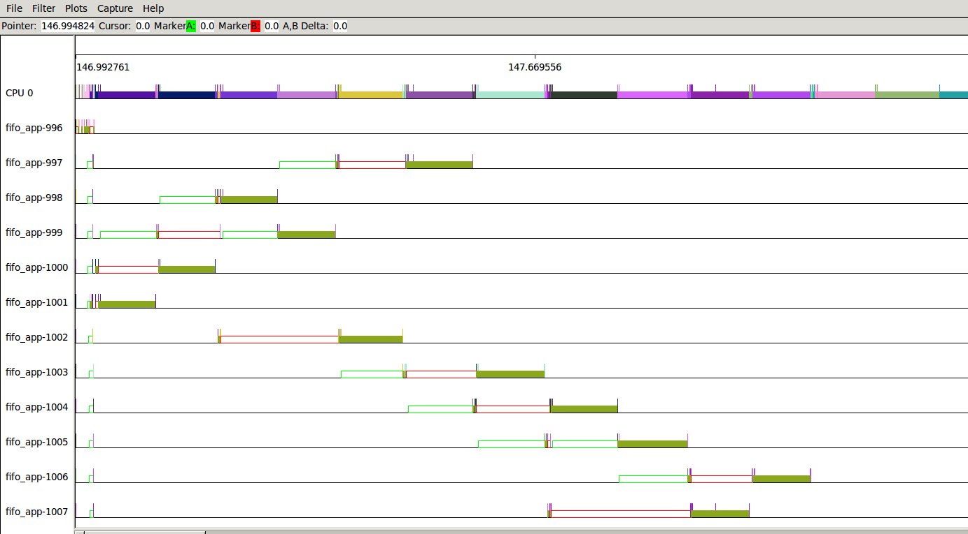
kernelshark
kernelshark 실행 후 분석

Slide 14
RR scheduler 트레이스
trace-cmd 실행
nfs 폴더로 이동
/nfs # trace-cmd record -e sched /root/sched/rr_app

Slide 15
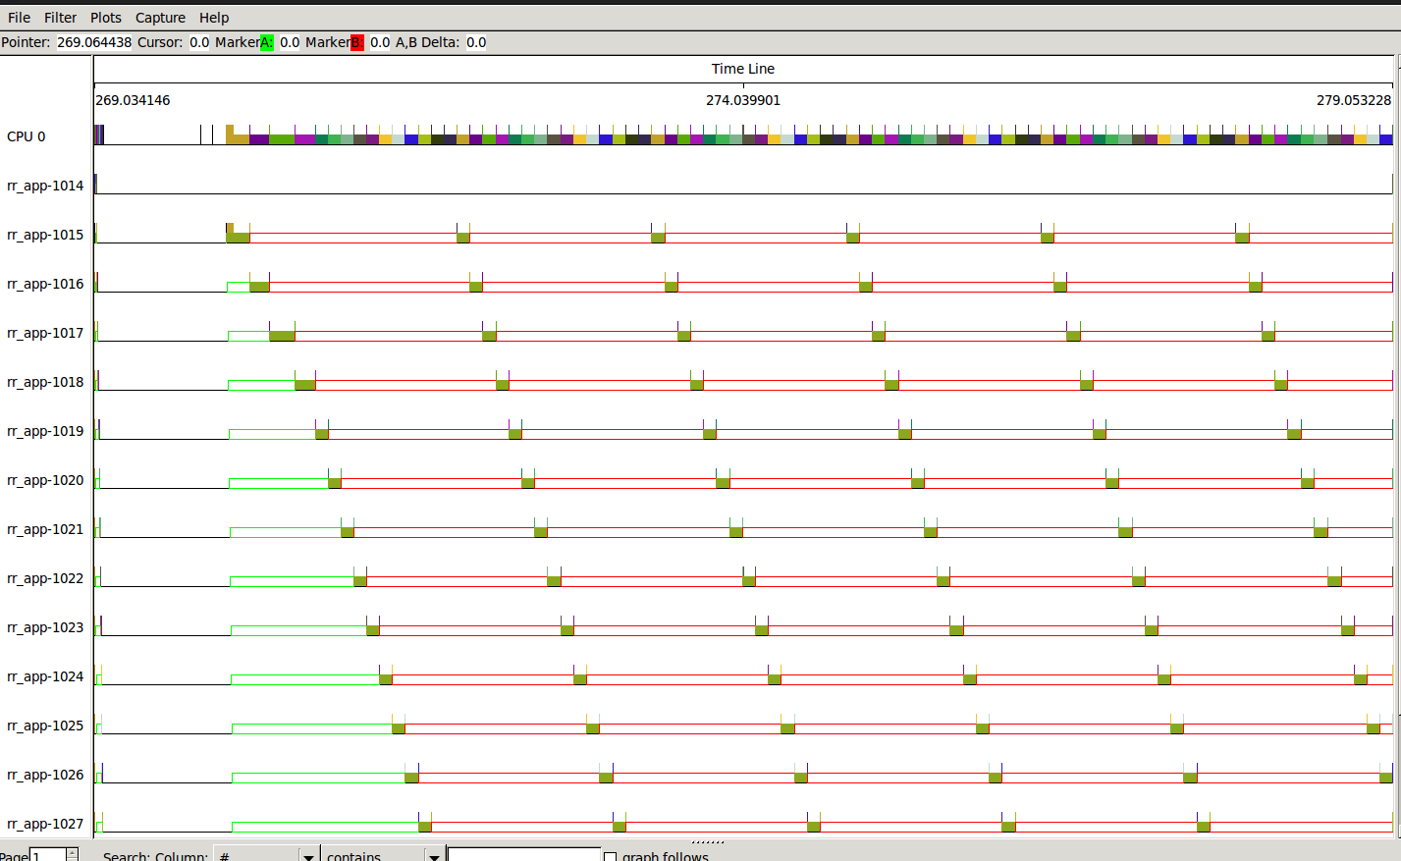
kernelshark
kernelshark 실행 후 분석

Slide 16
Simplified 리눅스 스케줄러
kernel/sched/rt.c
기존 리눅스 real-time scheduler는 복잡함
분석을 위해 단순화 시킴

Slide 17
Key Functions in Scheduling Class
enqueue_task
put the task into the run queue
increment the nr_running variable
dequeue_task
remove the task from the run queue
decrement the nr_running variable
yield_task
relinquish the CPU
check_preempt_curr
check whether the currently running task can be preempted by a new task
pick_next_task
choose the most appropriated task
load_balance
trigger load balancing code

Slide 18
Simplified 리눅스 스케줄러
kernel/sched/rt.c

Slide 19
enqueue_task_rt()
kernel/sched/rt.c

Slide 20
dequeue_task_rt()
kernel/sched/rt.c

Slide 21
check_preempt_curr_rt()
kernel/sched/rt.c

Slide 22
task_tick_rt()
kernel/sched/rt.c

Slide 23

Next Step.
Energy-aware scheduling: EAS
CFS scheduler - Kernel level
Load Balancer(Group Scheduling, Bandwidth Control, PELT)
EAS features

Slide 24
Reference
https://pdos.csail.mit.edu/6.828/2016/schedule.html
http://web.mit.edu/6.033
http://www.rdrop.com/~paulmck/
“Is Parallel Programming Hard, And If So, What Can You Do About It?”
Davidlohr Bueso. 2014. Scalability techniques for practical synchronization primitives. Commun. ACM 58
http://queue.acm.org/detail.cfm?id=2698990
"CPUFreq and The Scheduler Revolution in CPU Power Management", Rafael J. Wysocki
https://sites.google.com/site/embedwiki/oses/linux/pm/pm-qos
https://intl.aliyun.com/forum/read-916
User-level threads : co-routines
http://www.gamedevforever.com/291
https://www.youtube.com/watch?v=YYtzQ355_Co
Scheduler Activations
https://cgi.cse.unsw.edu.au/~cs3231/12s1/lectures/SchedulerActivations.pdf
https://en.wikipedia.org/wiki/FIFO_(computing_and_electronics)
http://jake.dothome.co.kr/
http://www.linuxjournal.com/magazine/completely-fair-scheduler?page=0,0
https://www2.cs.uic.edu/~jbell/CourseNotes/OperatingSystems/6_CPU_Scheduling.html
"Energy Aware Scheduling", Byungchul Park, LG Electronic
“Update on big.LITTLE scheduling experiments”, ARM
“EAS Update” 2015 september ARM
"EAS Overview and Integration Guide”, ARM TR
“Drowsy Power Management”, Matthew Lentz, SOSP 2015
https://www.slideshare.net/nanik/learning-aosp-android-hardware-abstraction-layer-hal
https://www.youtube.com/watch?v=oTGQXqD3CNI
https://www.youtube.com/watch?v=P80NcKUKpuo
https://lwn.net/Articles/398470/
“SCHED_DEADLINE: It’s Alive!”, ARM, 2017

